Slide 1
ASP.NET Core

Slide 2
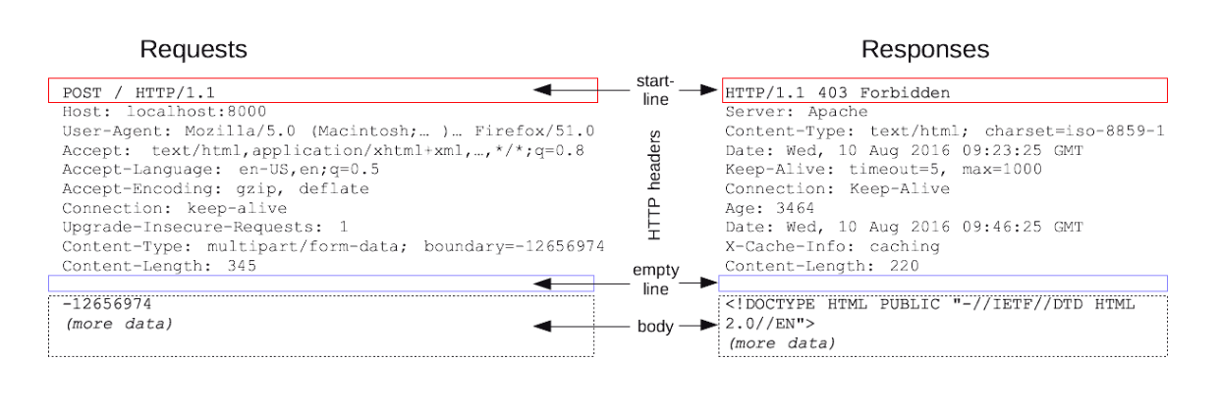
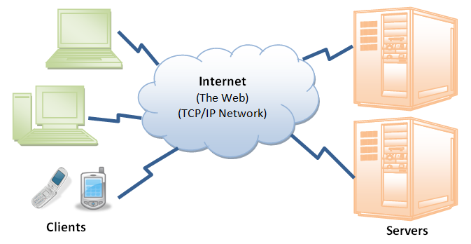
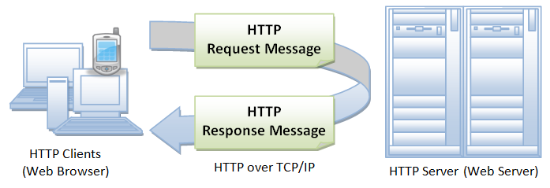
Http Request Responce Cycly
Notes:
Http Request Response Cycle
HTTP messages are how data is exchanged between a server and a client. There are two types of messages: requests sent by the client to trigger an action on the server, and responses, the answer from the server.
HTTP requests, and responses, share similar structure and are composed of:
1. A start-line describing the requests to be implemented, or its status of whether successful or a failure. This start-line is always a single line.
2. An optional set of HTTP headers specifying the request, or describing the body included in the message.
3. A blank line indicating all meta-information for the request have been sent.
4. An optional body containing data associated with the request (like content of an HTML form), or the document associated with a response. The presence of the body and its size is specified by the start-line and HTTP headers.
HTTP Requests
Start Line
HTTP requests are messages sent by the client to initiate an action on the server. Their start-line contain three elements:
1. An HTTP method, a verb (like GET, PUT or POST) or a noun (like HEAD or OPTIONS), that describes the action to be performed. For example, GET indicates that a resource should be fetched or POST means that data is pushed to the server (creating or modifying a resource, or generating a temporary document to send back).
2. The request target, usually a URL, or the absolute path of the protocol, port, and domain are usually characterized by the request context.
3. The HTTP version, which defines the structure of the remaining message, acting as an indicator of the expected version to use for the response.
Headers
HTTP headers from a request follow the same basic structure of an HTTP header: a case-insensitive string followed by a colon (':') and a value whose structure depends upon the header. The whole header, including the value, consist of one single line, which can be quite long.
Body
The final part of the request is its body. Not all requests have one: requests fetching resources, like GET, HEAD, DELETE, or OPTIONS, usually don't need one. Some requests send data to the server in order to update it: as often the case with POST requests (containing HTML form data).
HTTP Responses
Status Line
The start line of an HTTP response, called the status line, contains the following information:
1. The protocol version, usually HTTP/1.1.
2. A status code, indicating success or failure of the request. Common status codes are 200, 404, or 302
3. A status text. A brief, purely informational, textual description of the status code to help a human understand the HTTP message.
A typical status line looks like: HTTP/1.1 404 Not Found.
Headers
HTTP headers for responses follow the same structure as any other header: a case-insensitive string followed by a colon (':') and a value whose structure depends upon the type of the header. The whole header, including its value, presents as a single line.
Body
The last part of a response is the body. Not all responses have one: responses with a status code, like 201 (Created) or 204 (No Content), usually don’t.
The request-response cycle begins with a client sending a request message to a server. The server handles the request and sends a response message back to the client.

Slide 3
ASP.NET Core Fundamentals
Introduction
Notes:
ASP.NET Core Fundamentals
ASP. NET is the new web framework for Microsoft. It's been redesigned from the ground up to be fast, flexible, modern, and work across different platforms. Moving forward, ASP. NET Core is the framework you want to use for web development with. NET. In this course, we will build an application by starting from an empty project, so you can see how all the pieces come together.

Slide 4
ASP.NET Core Funcamentals
Install middleware
What’s new
Work with SQL Server
Implement forms
Use CSS & Javascript libraries
Notes:
ASP.NET Core Fundamentals
We'll install middleware to build a processing pipeline, and then move on to work with the MVC framework. If you have any experience with MVC or web API over the last few years, you'll notice some familiar features.
We still have models, views, and controllers, but we’ll also see what's new, as we look at tag helpers, view components, and how dependency injection is a first class design pattern.
We'll also see how to work with SQL Server using the new entity framework, implement forms authentication using the ASP. NET identity framework, and install and use CSS and JavaScript libraries like Bootstrap and jQuery.
By the end of the course, you'll have everything you need to start using ASP. NET Core and write an application that can create, edit, and view data from a database.

Slide 5
ASP.NET Core Fundamentals
Building Your First ASP.NET Core Application
Notes:
ASP.NET Core Fundamentals
This course will help you build your first application with ASP. NET Core.
In this course, we'll be using the new ASP. NET Core Framework version 2.2 to build a web application with APIs that can display and edit restaurant information.
We're going to spend our time focusing on the ASP. NET Core Framework.
In this first module, We will show you a couple different techniques that you can use to get started with your first project.

Slide 6
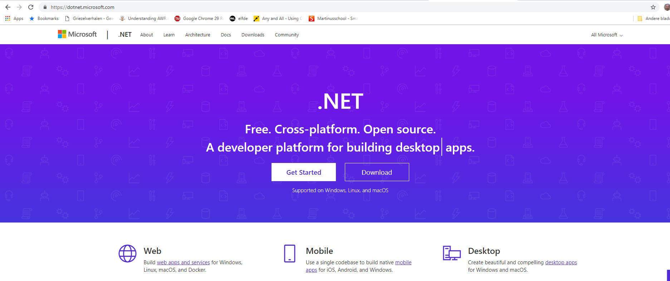
Setup
Notes:
Setup
For setup, we need to make sure that you have the. NET Core Framework installed on your computer.
If you go to the webpage http://dotnet.microsoft.com. You can download the various flavors and versions of the. NET Framework.

Slide 7
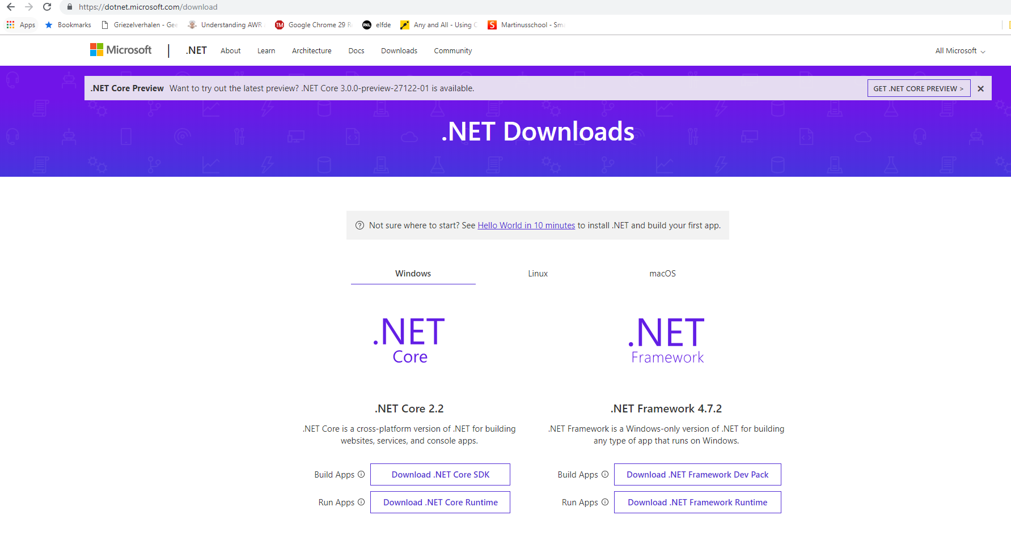
Setup
Notes:
Setup
What we’re interested in is downloading. NET Core. So after following the link, you will come to a page that shows all of the. NET Core downloads.
We’re going to download a package that is the. NET Core SDK, or Software Development Kit.
The SDK includes all the tools that you would use to create a. NET Core project.
Once you follow one of these links and run the installer, or follow the instructions to install the package that you downloaded, it is then time to select an editor that you can use for writing code.
You can use any text editor when writing code for. NET Core. There are no ties to the Microsoft Editors and IDEs.
In this course, we will mostly be using Visual Studio. We’ll be using Visual Studio 2017, make sure you install the latest updates.
I'll be using Visual Studio 2017 with update 3, because that includes some tools that makes .NET Core development with 2.2 a little bit easier.
This version of Visual Studio only works on Windows, but there is also a version of Visual Studio for the Mac.
And if you want a more lightweight experience on Windows or the Mac or on Linux, you can download Visual Studio Code, and we will be showing you some features of Visual Studio Code throughout this course.
But once you have the SDK installed, and once you have your tool of choice installed, it's time to create your first project. Let's do that with Visual Studio 2017 first.

Slide 8
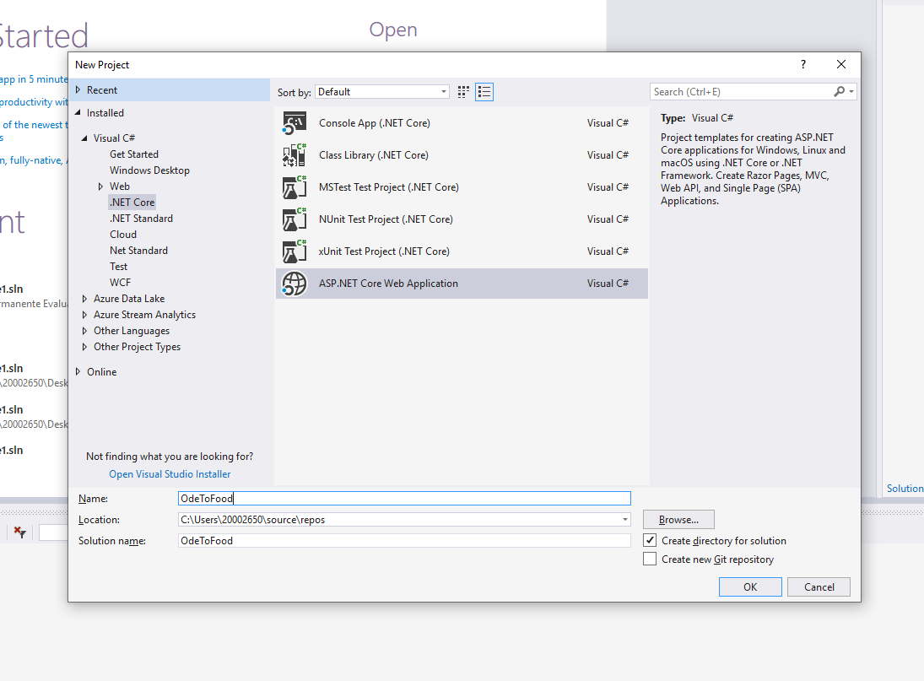
Setup a new Project
File → New Project
Notes:
Setup a new Project
Inside of Visual Studio 2017, You can start a new project by going to the File menu, selecting New, and then select Project. This will launch the new project dialog where you can select the general type of project that you want to create.
We want to create a. NET Core Visual C# project. And specifically in the templates that are listed for. NET Core, we want to create an ASP. NET Core Web Application.
We can give my application a name. Let's call this OdeToFood, because it will be all about restaurants.
With those settings in place, We can select OK,

Slide 9
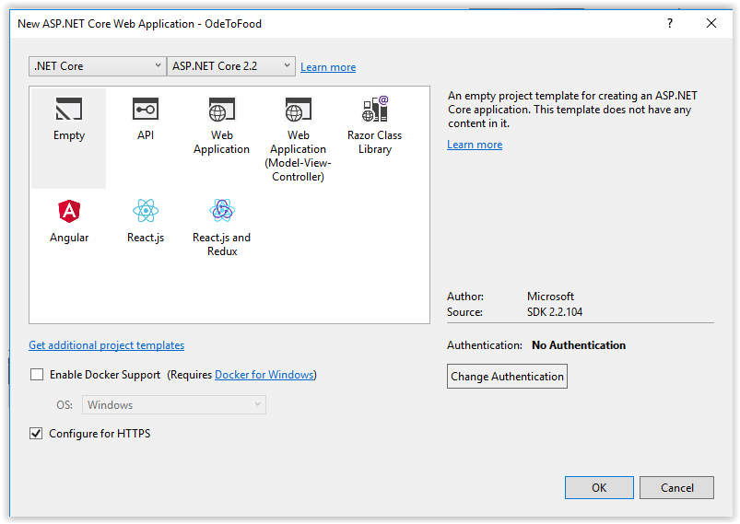
Setup a new Project
Notes:
Setup a new Project
The next dialog that appears will offer you various different starting points for your application. First of all, you do want this to run on. NET Core. You do want to make sure that you have ASP. NET Core 2.2 selected. Then the various templates inside of here, you can start with an empty project, or with a project that is geared or set up towards producing a Web API, which would be an HTTP-based API. You can also create a web application, and there are templates to work with various front-end frameworks, like React.
Since we really want to take a look at how things work and how to put things together from scratch, We’re going to select the empty template. The empty template is going to produce a project that will have the bare minimum of ASP. NET Core inside. Once you press OK, Visual Studio will go out and create that project and will create a solution for that project to live inside of, and it will go out and automatically restore any NuGet dependencies that are required by this project, the libraries that we’re going to use when we’re building our web application.

Slide 10
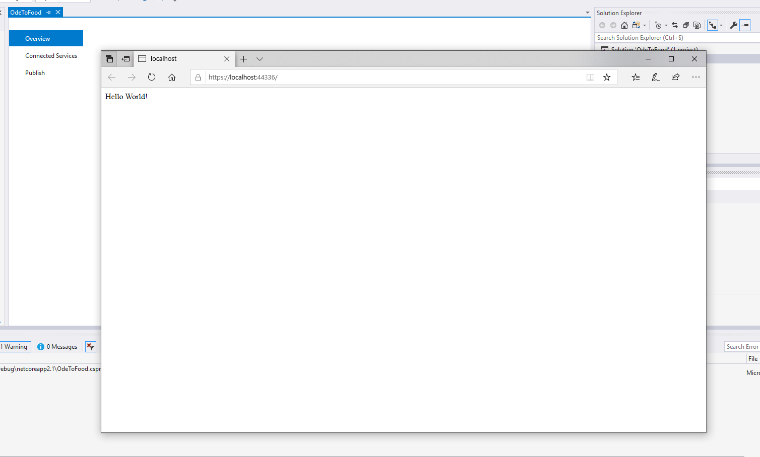
Setup a new Project
Debug → Start Without Debugging
Notes:
Setup a new Project
As soon as all of that work is finished, let‘s go to the Debug menu and say Start Without Debugging (Ctrl+F5).
We don't want to debug and step through our program, we just want to give this is a quick run and see if everything is working. By default, this empty application, can only display the text Hello World! That's how simple it is.
But call your attention to a couple things.

Slide 11
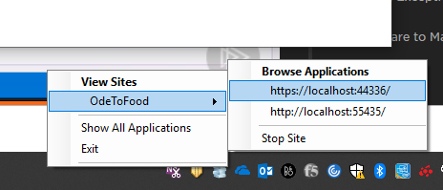
Setup a new Project
Notes:
Setup a new Project
First of all, if we go into the Windows System Tray, you can see a little icon for IIS Express. That's the development web server that Microsoft ships with Visual Studio. If you right-click on this icon, you can see that your application, OdeToFood, is running in this version of IIS, it's running on localhost and port 55435.
Those ports are randomly assigned, so you might see a different port number, and that's okay.
If you've done any ASP. NET development in the past, all of this might look very familiar. You create an ASP. NET project by going to File New Project. You can run that project and Visual Studio will launch IIS Express to host the application, and then launch a web browser to browse to that URL and IIS Express where the application lives.
But there are some significant differences between ASP. NET and ASP. NET Core. We will see some of those differences as we move through the course and uncover features of ASP. NET Core, but before we start figuring out what is inside of this project and how we can make this application behave differently, let's take a look at another way to create a new ASP. NET Core application, this time using tools that you could use in any environment, from macOS, to Linux, to Windows.

Slide 12
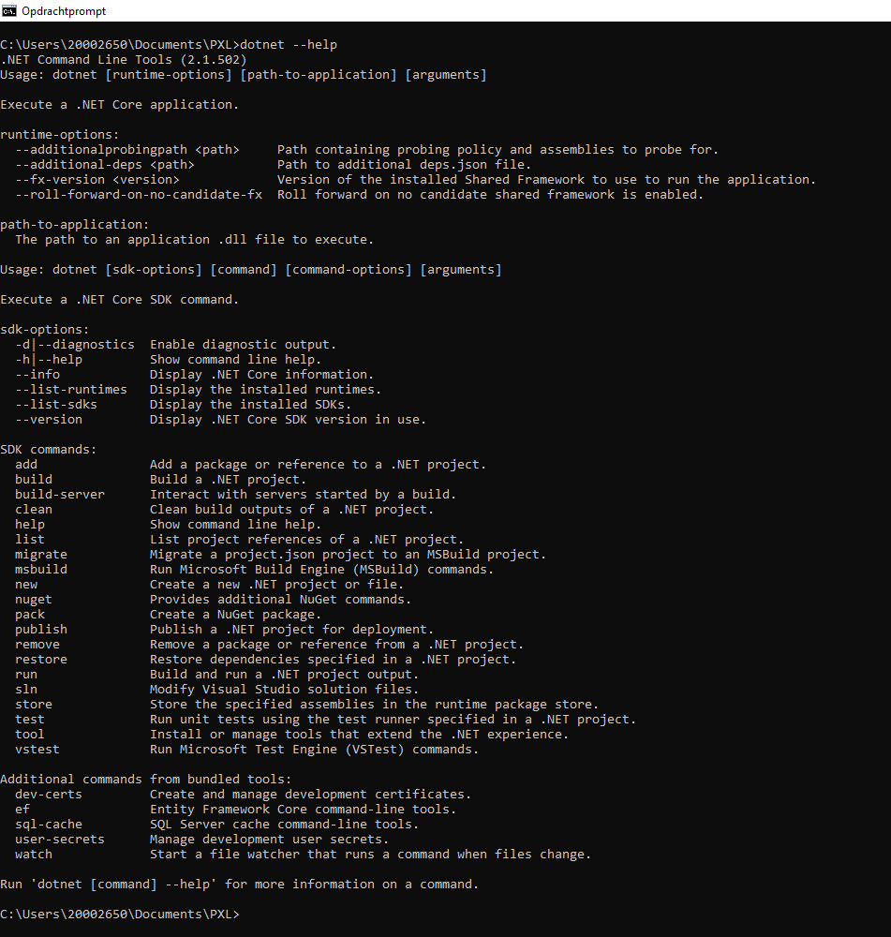
Command line tools and Code
>dotnet --help
Notes:
Command line tools and Code
For those of you working on macOS or Linux, and even for those of you who work on Windows, we want to show you another approach that you can use to create, run, and modify an ASP. NET Core web application.
We’ll start by opening up a Command Prompt or a Shell. Because regardless of what platform you're on, you should be able to come to your command-line interface and execute the command “dotnet”.
This is the .NET Core command-line interface, or CLI.
You can ask the CLI what version of. NET Core you’re running and you can also ask dotnet for some additional help: dotnet --help.
You get the list of commands that are available with dotnet.
You can create a new project with this command-line interface.
You can also run a project and build a project, that is, compile all of your source code files.
Anything that you can do with Visual Studio, you can also do with this command-line tool, which is a cross-platform tool.
It will run anywhere that is supported by .NET Core.

Slide 13

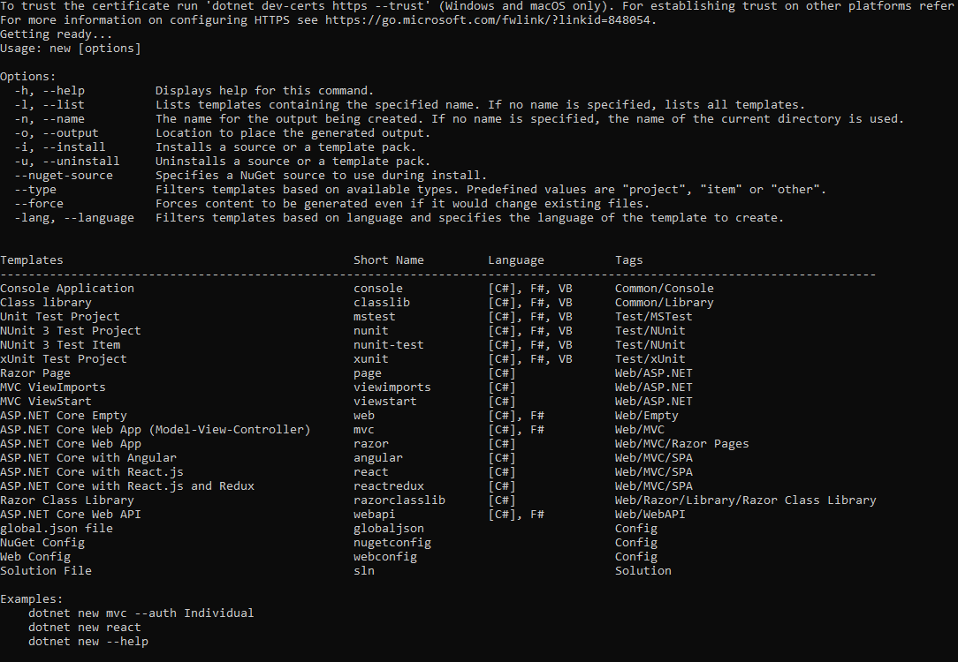
Command line tools and Code
Notes:
Command line tools and Code
Let's take a look at the option to create a new project. Switch switch over into your development folder and make a new folder, temporarily called OdeToFood2 and switch into that folder.
Inside of here, we run dotnet new. You will see a help screen that basically tells you, you haven't provided enough information to create a new project.
One of the options that you have to specify, is the type of template that you want to use to create this new project.
This list of templates will look very familiar after seeing the File New Project dialog in Visual Studio.
Just like in Visual Studio, there's a template to create an empty ASP. NET Core project, as well as a full web app, as well as a web app with Angular and with React. js.
If you run dotnet new web, you get an ASP. NET Core Empty project, the default language will be C#, and this project will contain the same files and have the same behavior as the project that you created using Visual Studio.

Slide 14
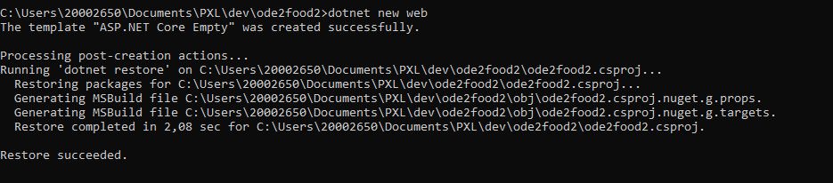
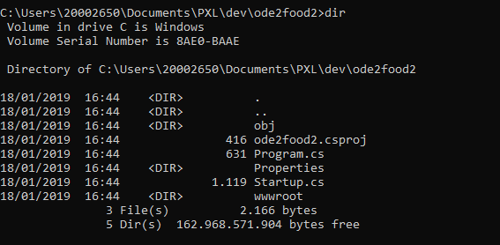
Command line tools and Code
Notes:
Command line tools and Code
Let's try dotnet new web.
Dotnet will infer the name of your project from the name of the folder that you’re in, so this is the OdeToFood2 project.
If you do a directory listing, you can see just like in Visual Studio, you have a Program.cs, a Startup.cs, and a wwwroot folder.
We're going to explain the purpose of those files and that directory as we move throughout this course.

Slide 15
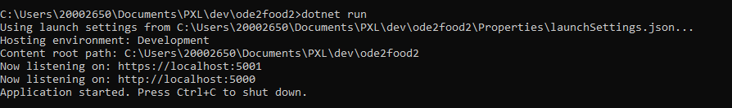
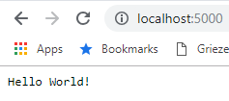
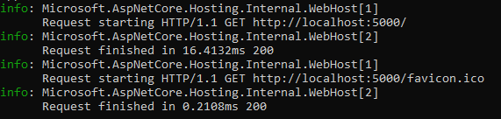
Command line tools and Code
Notes:
Command line tool and Code
For right now, we just want to dotnet run this project to see how this web application behaves.
Behind the scenes, dotnet run will see that the project hasn't been built yet, it will build the project and start the application.
Now, this time, since we’re not in Visual Studio, we’re running this from the command-line, we won't be using IIS Express.
IIS Express only works on Windows. Instead, we have an application that started its own web server, and this web server is listening on localhost:5000.
By the way, we could execute this same command, dotnet run, in the folder where OdeToFood exists, and we would have the exact same behavior. There are no ties between. NET Core and ASP. NET Core in Visual Studio.
What we should be able to do now is open up a web browser and come over to localhost:5000, and just like with the project that we created in Visual Studio, we see the output Hello World!
We know that request reached this OdeToFood2 project, because you can see some logging statements that indicate that a request started and a request finished.
Press Ctrl+C to stop that application

Slide 16
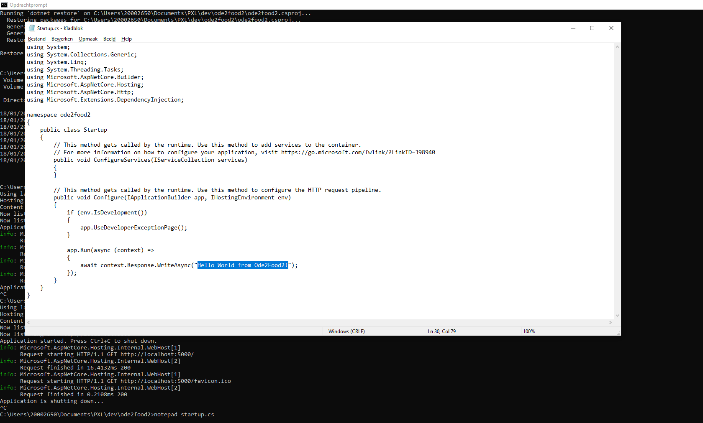
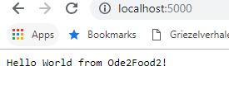
Command line tools and Code
Notes:
Command line tools and Code
Let’s use Notepad to have a look at the file Startup.cs. Again, more on this file later in the course. For right now, we just want to call your attention to the string literal at the bottom of the file Hello World. That is the response that is being sent to the browser for every request to this web application, that's all you can do. We’re going to modify this to ‘Hello World from OdeToFood2’ and save this file to show you that you can use any text editor and any tools that you want to interact with an ASP. NET Core project. There are no ties to Visual Studio or Windows.. NET Core is a cross platform framework. You can go back into your command history and execute dotnet run again. Dotnet run will see that a file has changed. It will recompile the application. And again, we're listening on locahost:5000. If you do a refresh, you can see that the change that you made to that C# file is now reflected in the output of your program.

Slide 17
Visual Studio Code
Download Visual Studio Code from https://code.visualstudio.com/download
Install Visual Studio Code
Add C:\users\{username}\AppData\Local\Programs\Microsoft VS Code to your path (PATH=c:\.....:$PATH) (or check the option during installation)
Install the C# intellisence extension (Extensions on Visual Studio Code webpage)

Slide 18
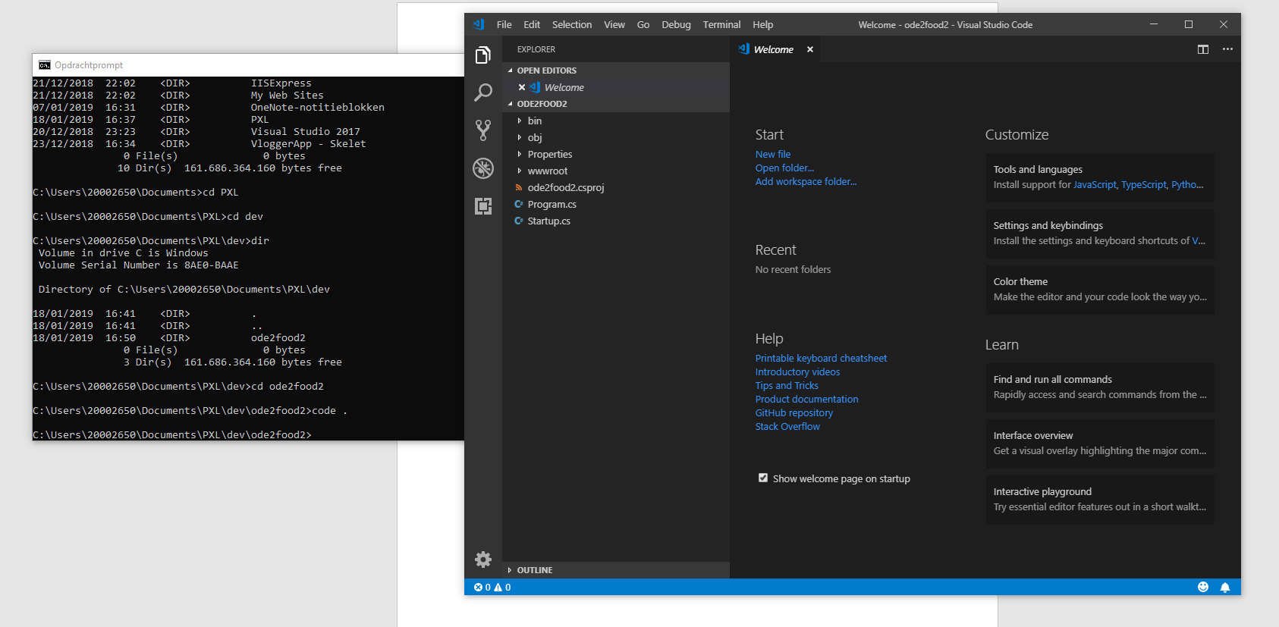
Command line tools and Code
Notes:
Command line tools and Code
Let’s open up this new project in Visual Studio Code (You could also open up this project with Visual Studio if I wanted to).
There is a csproj file in the folder, a C# project file. That's a project file that Visual Studio understands.
So you could open this application and edit this application with Visual Studio. More details on csproj in just a moment.
You could also open this application with Visual Studio Code.
When you install Visual Studio Code, there's an option to put the code command in your path.
That allows you to launch Visual Studio Code from the command-line “code .”.
And by passing in this extra dot, We’re telling Visual Studio Code to open the current folder as a project.

Slide 19
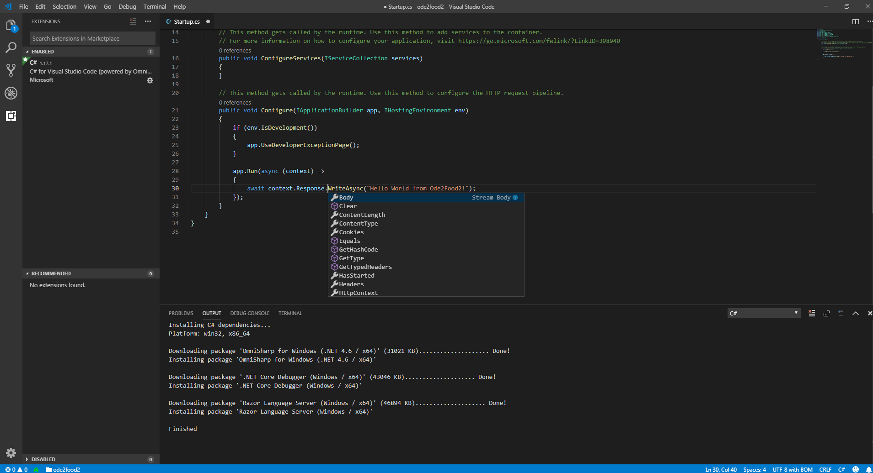
Command line tools and Code
Search for
extension
Notes:
Command line tools and Code
When you do that and open up this project, you can see the files that are inside the folder.
There’s the Startup.cs file. You can modify this file again and change the text that's inside.
If you haven't used Visual Studio Code before, the experience is very similar to Visual Studio. There are features like IntelliSense.
So if I go up to your http context and go to the response object, you can see different things that you can do with the response. you can send files, you can do a redirect, and you can also run and debug your application from Visual Studio Code.
There's just a couple things that you'll want to install.
First of all, the square icon on the left, is a list of the extensions that are installed. You have to install the C# extension. If you currently don't have that installed, it's very simple to do a search for the C# extension. There will be an install button that you can click and that extension will get installed.
You can also see when you open up this project for the first time, a little prompt that says the required asset to build and debug are missing from this project. Do you want to add them? You can say yes.
What that will do is add a .vscode folder into the directory, and inside of that folder there will be a couple JSON files that tell Visual Studio Code what to do when you want to run this application or debug this application.

Slide 20
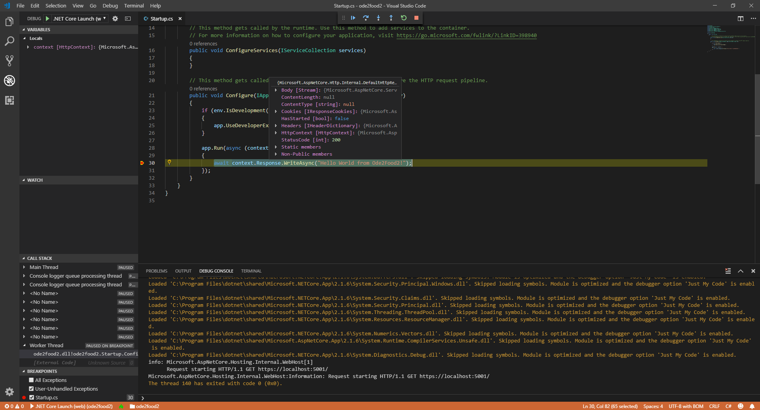
Command line tools and Code
Notes:
Command line tools and Code
When you click in the left-hand side beside the live numbers, you can add a breakpoint (little red circle).
When you click Debug→ Start debugging (or just press F5 ) it will build the application, it's going to again launch a web browser that points to localhost:5000.
The browser is not going to respond right away, because back there in Visual Studio Code you are sitting on that breakpoint.
You can now hover over variables and fields. You can continue, tell this to continue until you hit the breakpoint again or a breakpoint again. When you do that, you can see the response in the browser.
Stop debugging, and if you haven't used Visual Studio Code before, hopefully this little demonstration will show you the Visual Studio Code is a quite capable environment.
It's a tool that you can use across different platforms.
For the rest of this course, We will primarily use Visual Studio, but anything that we show you or do in Visual Studio, you could also do with Visual Studio Code, and ultimately, you could do with any text editor and the. NET CLI.

Slide 21
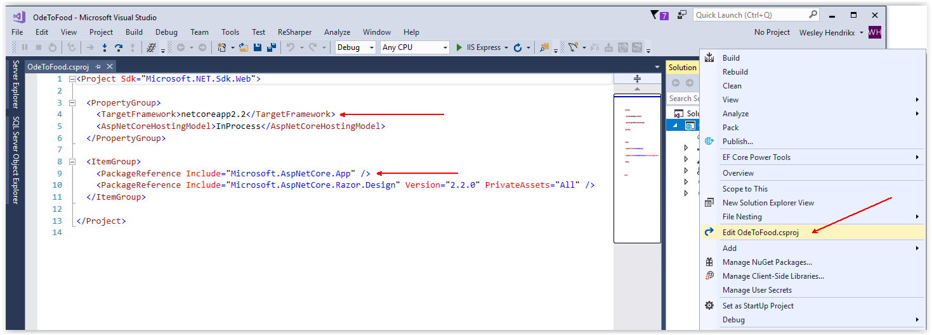
The ASP.NET Core Project Structure
Notes:
The ASP.NET Core Project Structure
Inside of Visual Studio, let's take a look at what is inside of our new empty project. This project isn't completely empty, of course, there's just enough code here to say Hello World, and we want to see how that works so we can understand how ASP. NET Core works.
First of all, both Visual Studio and the .NET CLI (that we just used), they both understand this application to be a. NET Core project, because there is a project file inside of the folder on the hard drive.
The project file for C# projects has a .csproj extension, and that file is displayed in Visual Studio Solution Explorer window as a node in a tree. Everything inside of that node is part of the OdeToFood project.
You can inspect the contents of your csproj file by right-clicking that node and going to the Edit OdeToFood.csproj context menu item. When you click this entry, just a couple observations.
First of all, for those of you who have edited csproj files inside of Visual Studio before, notice that you didn't have to unload your project to edit this file. The XML file simply opens up in an editor for you to modify. And secondly, the csproj file format is relatively simple compared to csproj files of the past.
There's two important pieces of information inside. First of all is the TargetFramework. The netcoreapp2.2 value, that's a moniker, or short name, that says your web application is going to use. NET Core version 2.2. You could also target the full. NET Framework, the desktop framework that is installed with windows. That would be a moniker like net46 for. NET 4. 6, or you could also use previous standards for. NET Core, for example, netcoreapp1.0.
The other piece of information is the ItemGroup with the package references. In the future, we're going to have additional package references, these are the NuGet packages, or the libraries, that your application depends on to do work.
Right now we have two single package references. The most important one is Microsoft.AspNetCore.App (that's what we call a metapackage, because it brings in additional packages). It's bringing in all the packages related to Microsoft AspNetCore.
Note that the files in de project (like Program.cs) are not listed in the project file. This is because all files in the project folder are considered to be a part of the project.

Slide 22
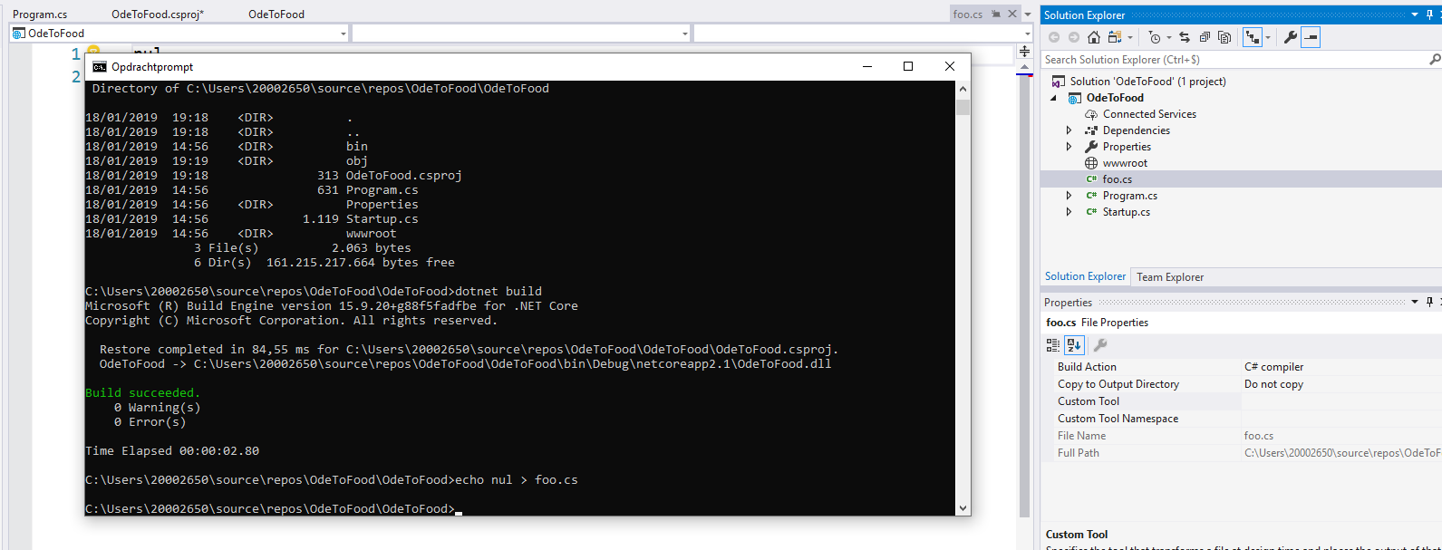
The ASP.NET Core Project Structure
Notes:
The ASP.NET Core Project Structure
To demonstrate that, we go back to the command-line.
We are inside the same folder that Visual Studio is pointing to, and from here, you could do a dotnet build or a dotnet run.
You could run this application just as easily from the command-line as you can from Visual Studio.
What we will do is add a new C# code file. We’ll echo a null character to a file and call it foo.cs.
When we press enter, we want you to watch the Solution Explorer window, because foo.cs will become part of your project.
You could edit this file using Visual Studio Code or Notepad or any editor, and the next time you do a dotnet build, foo.cs would be included as part of the compilation process.
If you delete foo.cs from the file system, foo.cs will disappear from Solution Explorer.
That's one important aspect of. NET Core and ASP.NET Core. The projects are now based on the file system.
Yes, there's a csproj file that includes information about what framework you’re targeting, what packages that you’re using, but there is no manifest that has to list everything that's in your project.
Any C# file that you place into this folder will be included as part of the build.

Slide 23
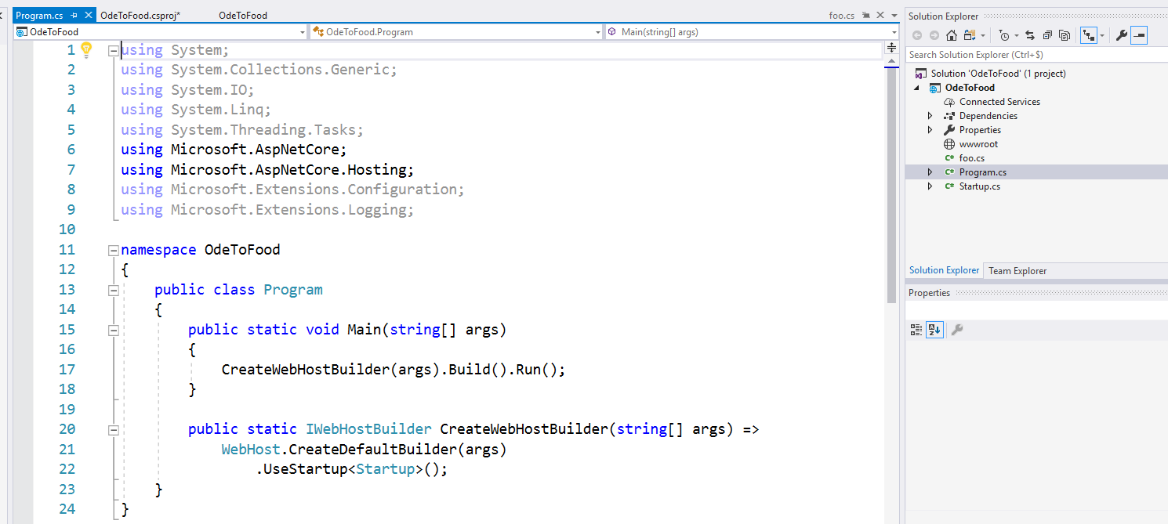
The ASP.NET Core Project Structure
Notes:
The ASP.NET Core Project Structure
There are two other C# files in this project: program.cs and startup.cs.
Program.cs
If you've ever written a console application, the structure of this file looks like the structure that you would see inside of a typical console mode application.
You have a program class, and you have a static void Main entry point that takes command-line arguments.
This is because an ASP. NET Core application is structured as a console mode application.
It's something you can run from the command-line. We did that previously with OdeToFood too, You did a dotnet run, that spun up a web server, and you could browse to that web server on localhost:5000.
You could do the same thing with this project when you do a dotnet run, what the dotnet runtime has to do is find an entry point for your program.
So it's going to look for the static void main entry point, and what this main entry point will do is build a web host, passing along any arguments from the command-line, and then tell that web host, or that web server, to start running.
When Visual Studio runs this particular project, it just happens to execute the same code, because behind the scenes it's all just dotnet run.
It will place this web host behind IIS Express, so IIS Express acts much like a proxy server. It's going to forward requests into your application.
Your application is a separate process that is up and running and has its own server.
That web server is configured inside of CreateWebHostBuilder. We're doing that by using a class from Microsoft.AspNetCore.Hosting, and that is the WebHost class that has a static method that makes this easy to spin up a web server.
It's called CreateDefaultBuilder, and once you have a web host builder, you need to configure that builder a little bit.
There are additional methods that you can invoke to customize this environment, but right now things are very simple. This is an empty project, after all.
We're simply telling that web host builder to use the Startup class to configure how the application should behave.
We'll look at Startup here in just a second, but after configuration, you can tell the web host builder to build itself, that gives back an IWebHost, and you can tell the web host to start running and listening for HTTP connections or HTTPS connections.
So program.cs and a static void main entry point are always a part of your ASP.NET Core application.

Slide 24
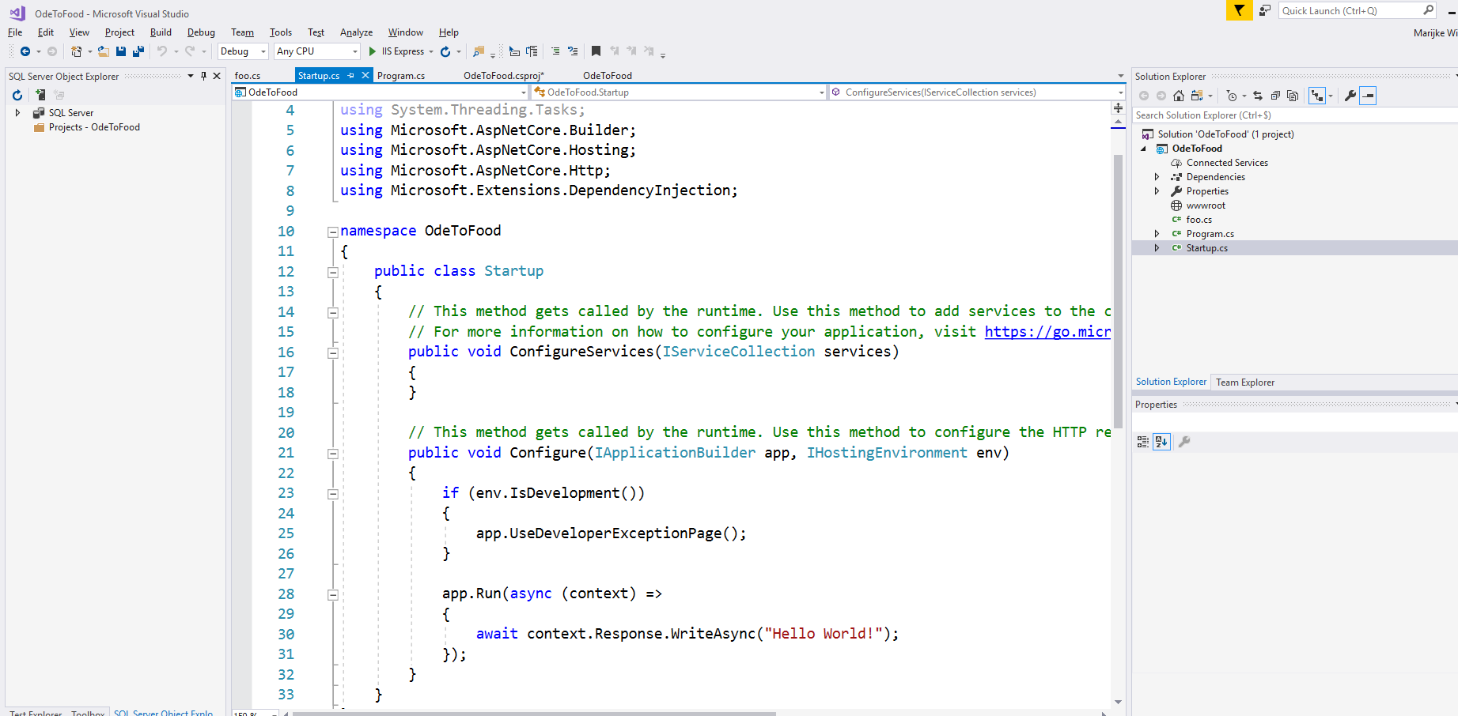
The ASP.NET Core Project Structure
Notes:
The ASP.NET Core Project Structure
Startup.cs
Most ASP.NET Core applications will also include the Startup class that will configure how the application behaves.
There's two methods inside of the startup class:
ConfigureServices
Configure
We'll look at these methods in much more detail in the next module.
For right now, we just want to tell you that the Configure method configures the HTTP processing pipeline for your ASP.NET Core application.
That is, for every HTTP message that arrives, it is the code inside of this Configure method that will define the components that respond to that request.
Right now we really just have a single piece of code that's going to say for every request that arrives, it doesn't matter what the URL is or what headers are present in that request, you just want to write out into the HTTP response a message that contains the text “Hello World”.
So, no fancy HTML, no JSON responses, we're simply going to respond to every request with this text “Hello World”.
Throughout the course, we will be customizing this Configure method so that we can use the MVC Framework, so that we can respond with HTML, so that we can respond with JSON for our APIs, but right at this moment, this is the only thing the application can do.
And for those of you that have done ASP.NET development in the past, notice in youre project there's no remnants of the previous version of the ASP.NET.
There is no global.asax, there is no web. config file.
In fact, in your project currently, there's no configuration file at all that you can use during runtime to hold configuration items, like a database connection string.
What we want to do next is show you how we can take this application and make this greeting message configurable.
That is, we want some sort of configuration file as part of your project that you can update either in development or in a production server that can change the text that we use to respond to every request.

Slide 25
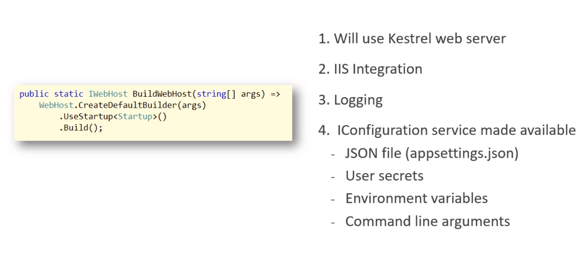
WebHost with CreateDefaultBuilder
Notes:
Adding a Configuration Source
To understand how we will add some configuration data to our application, we first have to understand the little bit of code that we saw inside of the program.cs file, specifically, the bit that says WebHost.CreateDefaultBuilder.
A web host builder is an object that knows how to set up our web server environment, and the default web host builder sets up our environment in a specific way.
These are settings we can change by writing our own builder code, but here is what happens with the default:
First, the default web host builder will set up the application to use the Kestrel web server. Kestrel is the codename for a web server that ships as part of ASP.NET Core. This is a cross-platform web server that runs on all platforms supported by .NET Core. It is this server that will listen for HTTP connections in our process, and it is this server that we can use directly if we run from the command-line.
The builder also sets up IIS Integration. If our application is running behind IIS, it is this integration that allows IIS to pass through Windows credentials to the Kestrel server that is running in our process. That's important if you're building intranet applications for users inside your company firewall; otherwise, you probably don't care about the IIS integration.
The builder also sets up some default logging, and we can see the output of this logging in the console when we run from the command-line, and in Visual Studio's output window when we run from Visual Studio. And again, all of these settings can be changed and customized, but here is the important part when it comes to configuration.
The default web host builder will create an object that implements an IConfiguration interface. We can access this object throughout our application, and we can retrieve configuration information through this interface. This is what we are about to demonstrate. By default, configuration information can come from a few different sources:
First, the configuration service can try to read settings from a file in the root of the project named appsettings.json.
The configuration service will also try to read values from a user secrets file. We will talk about user secrets later in the course.
We can also pass configuration values through environment variables and through command-line arguments.

Slide 26
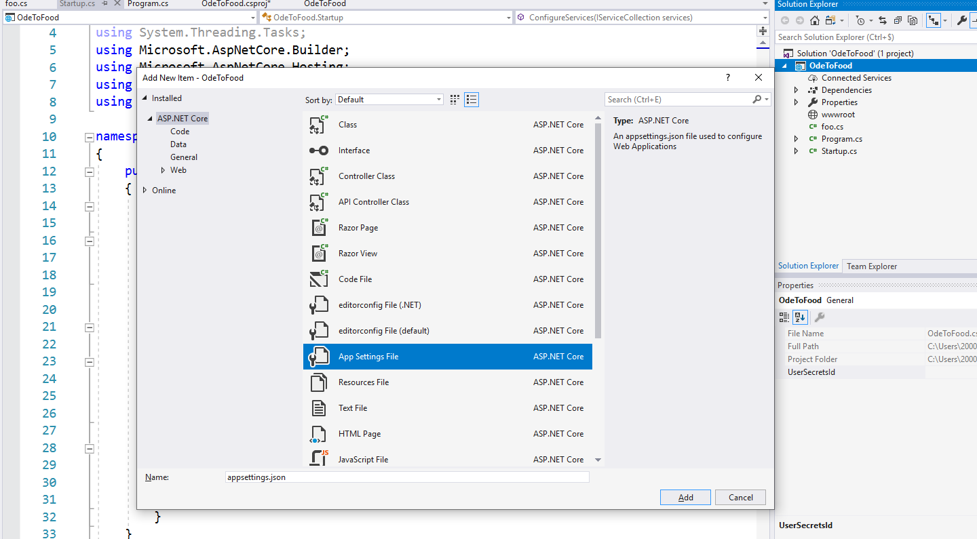
Adding a Configuration Source
Notes:
Adding a Configuration Source
So let's take a look at how to set up appsettings.json and use this IConfiguration service.
Our goal, again, is to replace this hard-coded string, “Hello World”, with a greeting that we read from a configuration source.
For those of you that have programmed in ASP.NET previously, we no longer use XML configuration files like web.config, but this WebHostBuilder, the default builder that we use inside of program.cs, will set up a configuration source that includes a JSON file named appsettings.json.
All we need to do is get a file named appsettings.json into the root of your project.
One way do that with Visual Studio is to right-click on the project, add a new item, and in this list of templates for different types of files that you can add, there is a template for “App Settings File”. It already has the appropriate name, which is appsettings.json. Depending on de version of .NET Core you are using, there might already be a appsettings.json present.

Slide 27
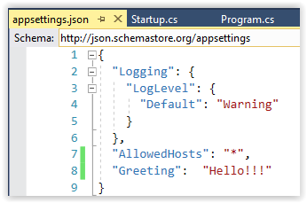
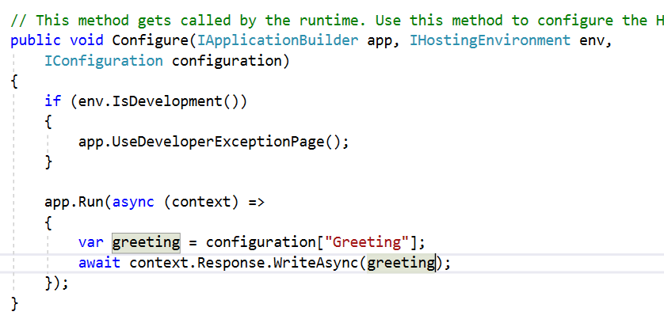
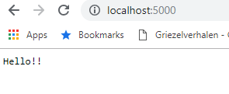
Adding a Configuration Source
Notes:
Adding a Configuration Source
Let’s add a new property to appsettings.json, which is the Greeting that we want you application to display.
The key to this configuration entry will be Greeting, and the value “Hello!!!”.
Let’s save this file. This is all we need in our configuration source.
Inside of Startup.cs, we need access to that IConfiguration service, so that you can read that value.
The way you can do that is to ask for another parameter in your Configure method. You can do this because ASP.NET Core uses dependency injection in various places throughout the framework.
One of those places is when ASP.NET Core invokes this Configure method.
ASP.NET Core will actually analyze the parameters that you’re asking for in this method, and if ASP.NET understands the types of those parameters, it will pass in a service or an object that can fulfill this requirement.
So for right now, this Configure method requires an IApplicationBuilder and an IHostingEnvironment. We'll talk about both of those more in the next module.
ASP. NET Core knows about those services, it knows objects that implement those interfaces, so it will pass those objects in.
We also want something that implements IConfiguration. To do that, we’re going to need to bring in a namespace, Microsoft.Extensions.Configuration. An easy way to do that is with the Ctrl+period option in Visual Studio.
We will name this parameter configuration. So now we have hopefully an object that we can use to read that greeting value.
Inside of this lambda expression, which is the little bit of code that executes for every request that we've received, let us first try to read that greeting value.
You can go to the configuration service, and you can index into this object using a key, that would be the name of the configuration entry in your file, which is Greeting.
That should give us a string back, which will be the value associated with that greeting.
Later in the course, we'll look at some more sophisticated techniques that we can use to map configuration items to complex objects, but for now we just want to pull out this string, and when the user makes a request to this website, we want to display that greeting.
We will save all the files in this project, and instead of running this application from Visual Studio, we’ll use the Command Prompt. Let's run the application here.
This time we will do a “dotnet run –v detailed”. This wil show a bit more logging information in the console.

Slide 28
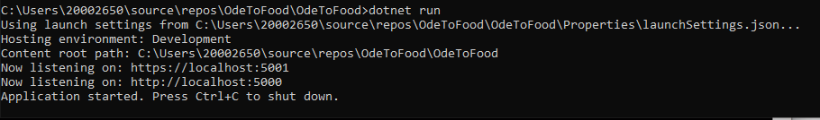
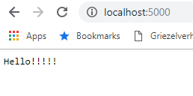
Adding a Configuration Source
Greeting from appsettings.json
Notes:
Adding an Configuration Source
When Visual Studio creates a new ASP.NET Core project, it does add a file called launchsettings.json, which is a configuration file that .NET the CLI tool will actually use to figure out how to get this process started.
Launch settings is telling dotnet run to launch and use a port of 5000.
You can go in there and look and tinker around if you want to see how to change some settings.
You can find the launchsettins.json in the Properties folder of your application.
All we want to do is go to the browser, let’s go to the port 5000, and we can see the value from my configuration file, which is Hello!!.
Now you might remember that we told you that this IConfiguration service actually uses a few different sources of configuration information.
So not only the appsettings.json file, but also environment variables and command-line arguments.
And the way this works is that if IConfiguration finds a setting inside of your appsettings.json file, it will use that setting.
But because IConfiguration also looks at environment variables next, if there's an environment variable named Greeting, that greeting value would override the setting in appsettings.json, and if there's a command-line parameter, which by default is the last configuration source added, a greeting value passed via the command-line will override both an environment variable and a setting inside of appsettings,json.
And this can be useful, because you can put some default settings for development inside of appsettings.json, and you can deploy that file into production, and when you set up your production server, if you create environment variables to override the settings inside of appsettings.json, that's one nice way to override things like a connection string for production and also keep secrets like database passwords on your server.
You don't have to check them into source control. But more on those scenarios later.

Slide 29
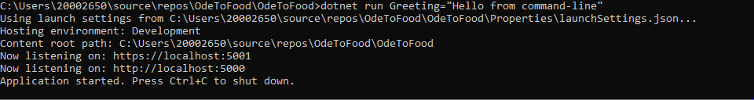
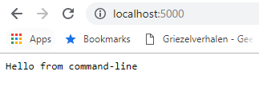
Adding a Configuration Source
Greeting from Command line parameter
Notes:
Adding a Configuration Source
We just want to demonstrate that if you come back to the command-line, let's kill this process. Now let's do a dotnet run and say that Greeting= and let's enter ‘Hello from command-line’ to see if we get the correct value. So once this process starts, we'll come back to the browser, and we will refresh on port 5000. We can see we get the configuration value that was specified from the command-line that's overriding or hiding the value that is in appsetting. json.
So hopefully this will give you a little bit of an idea of how configuration works in ASP.NET Core, and how we can use an IConfiguration Service. We'll see some more sophisticated techniques as we move throughout the course. But for right now, we return to this topic of dependency injection and how we can just ask for what seems like arbitrary things here inside of the Configure method.
Because what I want to do next is have this method not go directly to the configuration service, I want to create a custom greeting service that this method uses. And this greeting service might retrieve a greeting from the configuration source, but it might also go to a database or a web service. I'm going to abstract away the source of this greeting. And this will show you can implement your own custom service and have ASP.NET Core manage that service and inject that service into different components that will need that service.

Slide 30
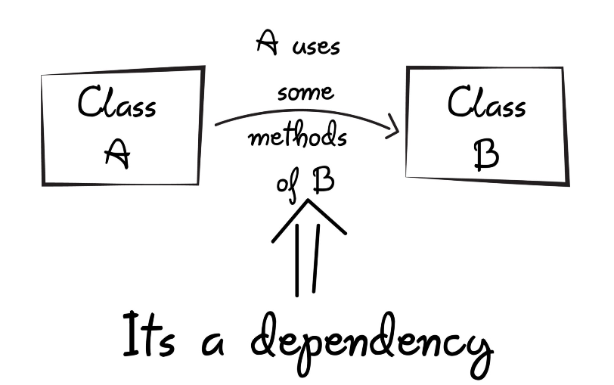
Dependency Injection
When class A uses some functionality of class B, then its said that class A has a dependency of class B.

Slide 31
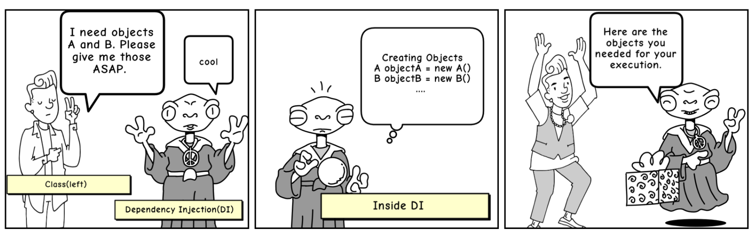
Dependency Injection
Before we can use methods of other classes, we first need to create the object of that class (i.e. class A needs to create an instance of class B).
Transferring the task of creating the object to someone else and directly using the dependency is called dependency injection.

Slide 32
Dependency Injection
Benefits of using DI
Helps in Unit testing.
Boiler plate code is reduced, as initializing of dependencies is done by the injector component.
Extending the application becomes easier.
Helps to enable loose coupling, which is important in application programming.

Slide 33
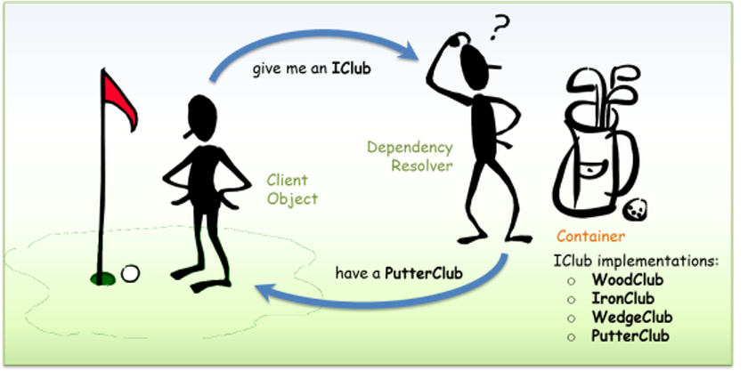
Dependency injection
Notes:
The Dependency Injection (DI) Design Pattern
At a high level, the goal of Dependency Injection is that a client class (e.g. the golfer) needs something that satisfies an interface (e.g. IClub).
It doesn't care what the concrete type is (e.g. WoodClub, IronClub, WedgeClub or PutterClub), it wants someone else to handle that (e.g. a good caddy).
The advantages of using Dependency Injection pattern and Inversion of Control are the following:
Reduces class coupling
Increases code reusing
Improves code maintainability
Improves application testing
Dependency Injection can be used to inject components that do business logic into your API controllers.
Dependency Injection also enables you to write API controllers in a test driven way (TDD).

Slide 34
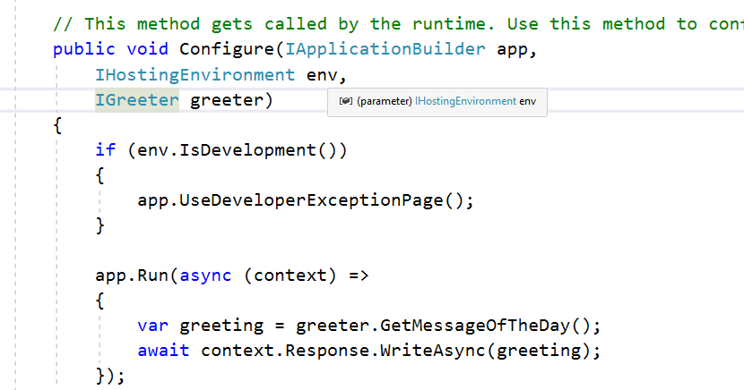
Creating and injecting Greeting Service
Notes:
Creating and injecting Greeting Service
Imaging instead of going directly to the configuration service, we had a service that implements an interface IGreeter.
We haven't created that interface yet, and before we do we just want to figure out what it would look like.
So instead of going to configuration, we want to go to the greeter service.
We want to get the message of the day. And behind the scenes, whatever object implements this interface, it might be going to a database, it might be going to a web service, it might be randomly picking a greeting from a text file full of greetings.
This code inside of the startup file doesn't really care; it just wants a service that implements this interface, so it can invoke a method and give back a string value to display to the user.

Slide 35
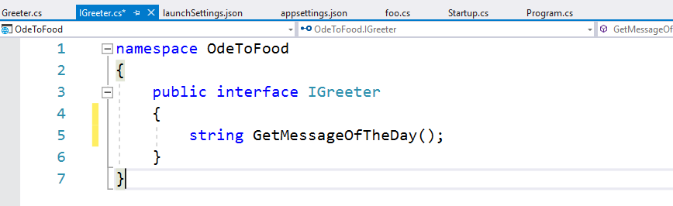
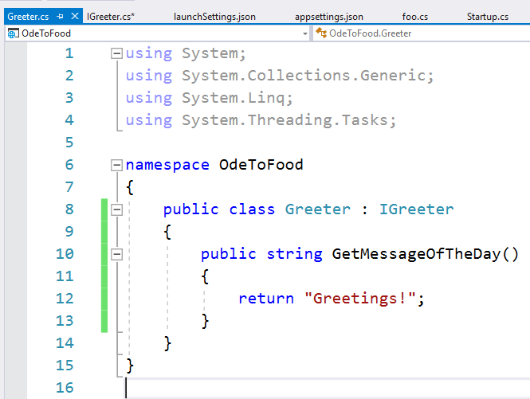
Creating and injecting Greeting Service
Notes:
Creating and injecting Greeting service
Let's use Visual Studio to create the IGreeter interface. You can do that by putting the cursor on top, pressing Ctrl+period, selecting the first entry, which is generate an interface IGreeter.
In IGreeter, we create a method, GetMessageOfTheDay, and we want this to return a value of type string.
Let's also go ahead and create a class, the Greeter class, that implements IGreeter. Let's start off with the simplest possible thing. We'll return a string that says “Greetings”.
We have an interface definition for our service, we have a concrete implementation for that interface that will still return a hard-coded string, we'll change that in just a bit, and we have a startup file that will ask ASP. NET Core for some object that implements IGreeter and use that object to get and display the message of the day.

Slide 36
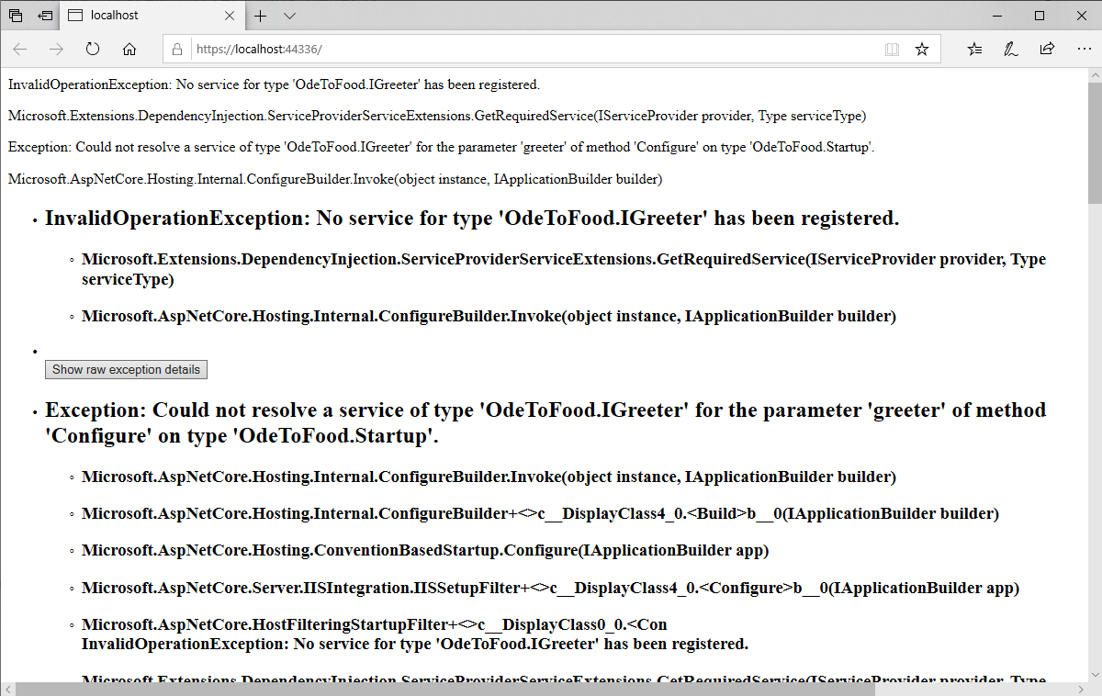
Creating and injecting Greeting Service
Notes:
Creating and injecting Greeting Service
In Visual Studio, let's start without debugging.
This application is not going to work yet, but the error message that we're going to see is going to be informative:
No service for type IGreeter has been registered.
So in order for ASP. NET to inject a service that implements IGreeter, we first have to configure this service.
I have to tell ASP. NET Core what do you use when some component in the system needs an IGreeter.
You see, some services have already been registered for us, so the IApplicationBuilder, the IHostingEnvironment (in Startup.cs), we wouldn't be able to get very far at all in an application if ASP. NET did not already have those services configured into the application.
But IGreeter is a custom service that we’re building, and we need to tell ASP. NET Core about this service.

Slide 37
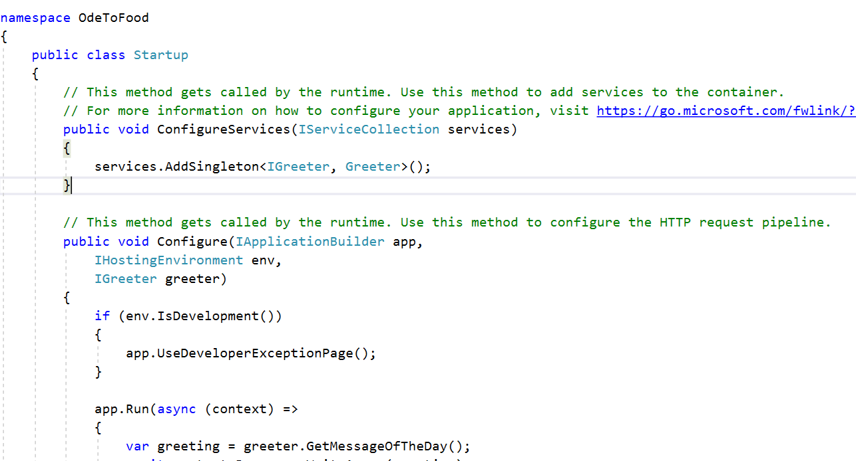
Creating and injecting Greeting Service
Notes:
Creating and injecting Greeting service
That's the purpose of the ConfigureServices method.
The Startup class really has two different responsibilities:
One is to give you a place (ConfigureServices) to register your custom services, so that ASP. NET Core can use those services and pass them around not only to itself, if you want to customize how the ASP.NET Core framework behaves, but also to other areas of the application like the Configure method.
The Configure method, its responsibility is to set up the HTTP processing pipeline that's going to be used to respond to requests.
Right now we respond to every request just by writing out a greeting, but in order to get this IGreeter, we need to register this service.
We can do that by walking up to this IServiceCollection object, and there's a number of methods and extension methods that will allow us to add services.
We can add an antiforgery service that's already built into ASP.NET Core.
We can add our own services.
There's a couple different ways that you can register a service and tell ASP.NET about the lifetime of that service, that is, how long should that service be around and when should ASP.NET create an instance and then tear down an instance of that service.
The AddSingleton method is a way of telling ASP.NET Core you will only ever need one instance of this service for the entire application.
There's also AddTransient, which is a method you can use to tell ASP.NET Core anytime someone needs an IGreeter, create a new instance for them. You don't need to keep it around or save it or reuse it.
There's also AddScoped. This will allow you to create a service that ASP.NET Core will create once per every HTTP request. The service is scoped to a specific request, and the service is reused throughout that request and then thrown away.
We'll be using these methods more throughout the course, and we'll explain some of the nuances between them.
For right now, we're just going to add a singleton. We’re going to tell ASP.NET Core whenever someone needs a service that implements the interface IGreeter, we create an instance of the following class, Greeter, and pass that service along.
There's a number of different overloads that allow you some control over how that instance is instantiated, but if we just use two different generic type parameters here, the first type parameter specifies the type of the service that we’re registering and the second generic type parameter Greeter, that tells ASP.NET Core about the implementation for that interface.
We don't need to provide any other code, because ASP.NET Core should be able to figure out how to create a greeter.

Slide 38
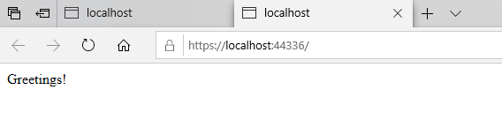
Creating and injecting Greeting Service
Notes:
Creating and injecting Greeting Service
With those changes in place, we rebuild, make sure there's no compile errors.
The build was successful so let's come back out to the browser window and do a refresh.
We can see we have a successful result.
So ASP. NET Core saw that we needed this IGreeter parameter, it was able to determine that that would require an instance of this Greeter class that we created, so ASP.NET Core instantiated that class and passed it along.
What's the big deal, you might be saying, why couldn’t we just inside of the Configure method say var greeter = new Greeter and create an instance of that class directly?
Well, the whole idea of managing these dependencies as parameters and receiving them indirectly instead of using the new keyword is that our software becomes a lot more extensible and flexible and testable.
Because now we’re not tied to a specific implementation of IGreeter inside of the Configure method, we can instead configure different types of greeting components to be used at runtime and not have to change anything inside of my application, except this ConfigureServices method.
We could also, inside of a unit test be able to invoke this method and pass in any greeter that we want, instead of trying to work around a greeter that was hard-coded into this method.
So that's one advantage of this dependency injection approach that ASP.NET Core takes, and we will see this again and again throughout the course, taking advantage of dependency injection.
The ability to take a dependency, like something that implements IGreeter, take that as a parameter to your method, so that dependency is passed to you instead of you creating it directly.

Slide 39
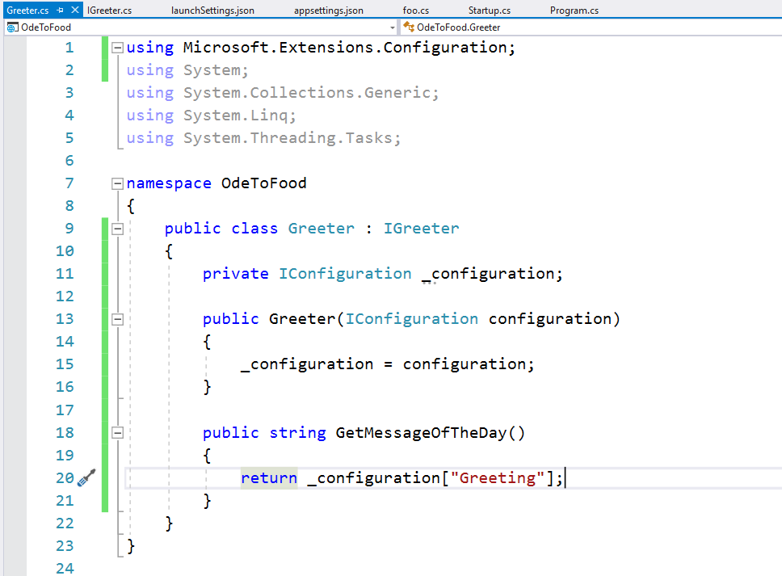
Creating and injecting Greeting Service
Notes:
Creating and injecting Greeting Service
And the neat thing about dependency injection is that you can create an entire graph of objects this way.
In other words, what would happen if your Greeter class had a constructor that required some parameters?
It's easy to see how ASP.NET Core could look at the class in this existing form and say all we need to do is construct a new instance of Greeter and constructing this class is easy; the constructor doesn't take any parameters.
But what if you wanted a parameter here like an IConfiguration service?
As we bring in the namespace (Microsoft.Extensions.Configuration), ASP. NET Core has a little more work to do inside of startup when it sees that there's a method that needs IGreeter.
It has to construct a Greeter, and it sees that the greeter itself requires some other service, IConfiguration.
Fortunately, the ASP.NET container, the dependency injection system, can figure all of this out.
It can analyze your Startup class discover it needs an IGreeter, so it creates the one that you specified.
When it looks at Greeter, it sees this needs an IConfiguration service, and that service has already been registered by our default WebHostBuilder.
What we could do inside of the Greeter is save off this configuration source into a field, and we'll generate that field with Ctrl+period.
Instead of returning a hard-coded string, we could go back to retrieving a greeting from our configuration file.
We have a little more flexibility now inside of Startup, because it doesn't necessarily need to know where that greeting comes from.
If that's an area of flexibility that we need in our software because we anticipate the source of this greeting might change in the future, then we have an extensibility point where we can create a different implementation of IGreeter and just plug that into the system.
Again, a quick build to make sure we don't have any compiler errors, and coming back to the browser, if we refresh, we are now back to the value that comes out of the configuration file.
So the goal of this exercise was fairly two-fold. One was to show you some of the inherent flexibility that ASP.NET Core offers, because it achieves extensibility and flexibility through this technique known as dependency injection, and the ability to register services and ask for services as parameters to your methods and to your constructors.
And this also hopefully gave you an idea around the configuration system in ASP.NET Core, how you can use appsettings.json and environment variables and command-line arguments to pass configuration information to your application. We will use both of these techniques and ideas moving forward throughout the course.

